Slide 1
OBJECT ORIENTED SOFTWARE ENGINEERING
FYMCA SEM-I
By:- Prof YUGANDHARA PATIL

Slide 2
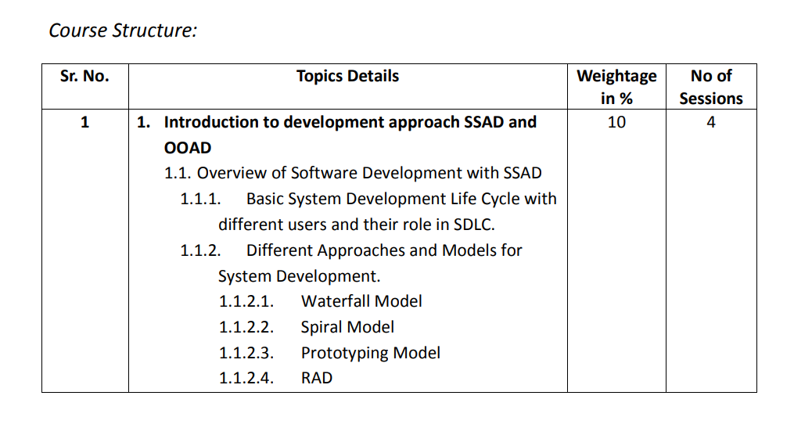

Slide 3
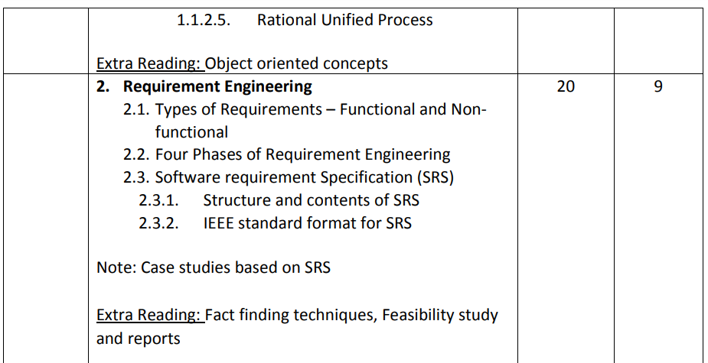

Slide 4
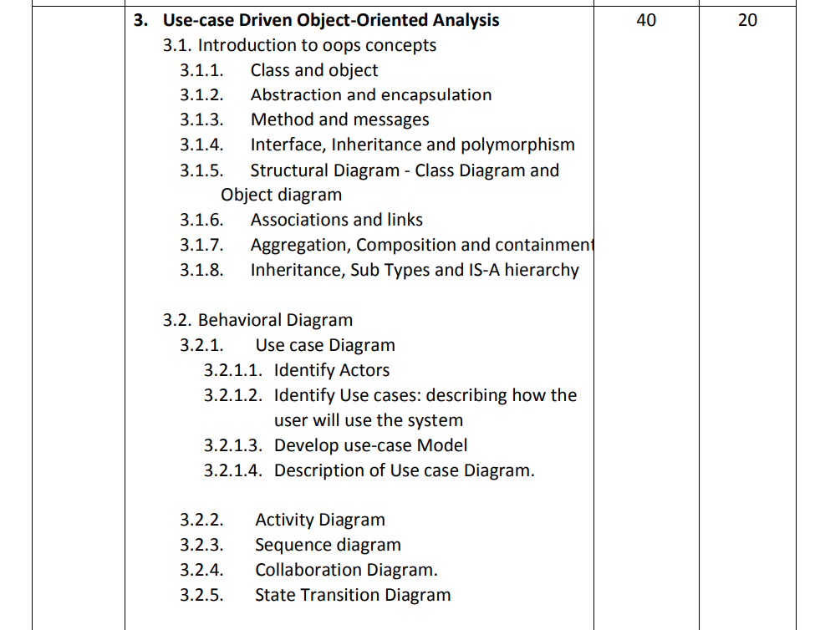

Slide 5
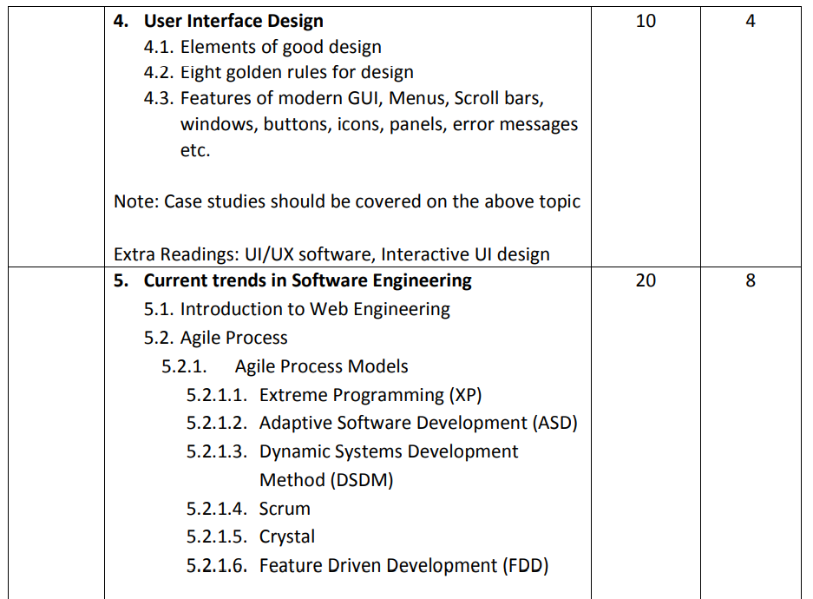

Slide 6
Introduction to SSAD and OOAD
• In Software Engineering there are two popular methods to model analysis and design problems: – Structured Systems Analysis and Design. (SSAD). – Object-Oriented Analysis and Design. (OOAD)
• A method is a specific set of formal tools and techniques used to model a problem.

Slide 7
SSAD :
In SSAD, the system is viewed as being composed of two components, functionality and data, each of which is modeled more or less separately. Functionality are modeled using a technique called process modeling. Data is modeled using a technique called data modeling. Since SSAD models functionality and data separately, we say that it follows a function/data methodology It is more suitable for data intensive projects

Slide 8
System Analysis :SSAD
The analysis stage produces a structured requirements specification consisting of the following deliverables: – A process model consisting of a set of data flow diagrams.
– A set of process specifications.
– A data model consisting of an entity-relationship diagram.
– A data-dictionary.

Slide 9
OOAD :
In the last few years, a new methodology has emerged which is in a sense an amalgamation of process-oriented and data-oriented methods.
This is called an object-oriented methodology.
This methodology is more suitable for projects with complex business logic

Slide 10
OOAD vs. SSAD
• Advantages of OOAD are
– Bringing Order to chaos
– Easy to Handle very Complex projects
– Driving principles: – maintainability, extensibility – reusability – interoperability – quality

Slide 11
OOAD vs. SSAD
OOAD has several obvious advantages over SSAD as OOAD is more close to the real world because it is based upon the object. Where SSAD fails after a certain level of complexity,
OOAD comes out with flying colors and handle the complexity in a robust and dependable manner.
OOAD is supported by various principles like maintainability, extensibility, reusability, interoperability and quality.

Slide 12
OOA
Object–Oriented Analysis (OOA) is the procedure of identifying software engineering requirements and developing software specifications in terms of a software system’s object model, which comprises of interacting objects.
The main difference between object-oriented analysis and other forms of analysis is that in object-oriented approach, requirements are organized around objects, which integrate both data and functions. They are modelled after real-world objects that the system interacts with. In traditional analysis methodologies, the two aspects - functions and data - are considered separately.

Slide 13
The primary tasks in object-oriented analysis (OOA) are −
Identifying objects
Organizing the objects by creating object model diagram
Defining the internals of the objects, or object attributes
Defining the behavior of the objects, i.e., object actions
Describing how the objects interact

Slide 14
Object-Oriented Design
Object–Oriented Design (OOD) involves implementation of the conceptual model produced during object-oriented analysis.
In OOD, concepts in the analysis model, which are technology−independent, are mapped onto implementing classes, constraints are identified and interfaces are designed, resulting in a model for the solution domain, i.e., a detailed description of how the system is to be built on concrete technologies.

Slide 15
The implementation details generally include −
Restructuring the class data (if necessary),
Implementation of methods, i.e., internal data structures and algorithms,
Implementation of control, and
Implementation of associations.

Slide 16
Objects and Classes
The concepts of objects and classes are intrinsically linked with each other and form the foundation of object–oriented paradigm.

Slide 17
Class
Class is a detailed description, the definition, and the template of what an object will be. But it is not the object itself.
Also, what we call, a class is the building block that leads to Object-Oriented Programming.
It is a user-defined data type, that holds its own data members and member functions, which can be accessed and used by creating an instance of that class.
It is the blueprint of any object.
Once we have written a class and defined it, we can use it to create as many objects based on that class as we want.

Slide 18
For example, consider the Class of Accounts.
There may be many accounts with different names and types, but all of them will share some common properties, as all of them will have some common attributes like balance, account holder name, etc.
So here, the Account is the class.

Slide 19
Object
Object is an instance of a class.
All data members and member functions of the class can be accessed with the help of objects.
When a class is defined, no memory is allocated, but memory is allocated when it is instantiated (i.e. an object is created).
For Example, considering the objects for the class Account are SBI Account, ICICI account, etc.

Slide 20
SDLC

Slide 21
Software Development Life Cycle (SDLC) is a process used by the software industry to design, develop and test high quality software's. The SDLC aims to produce a high-quality software that meets or exceeds customer expectations, reaches completion within times and cost estimates.
SDLC is the acronym of Software Development Life Cycle.
It is also called as Software Development Process.
SDLC is a framework defining tasks performed at each step in the software development process.
ISO/IEC 12207 is an international standard for software life-cycle processes. It aims to be the standard that defines all the tasks required for developing and maintaining software.

Slide 22
What is SDLC?
SDLC is a process followed for a software project, within a software organization.
It consists of a detailed plan describing how to develop, maintain, replace and alter or enhance specific software.
The life cycle defines a methodology for improving the quality of software and the overall development process.

Slide 23
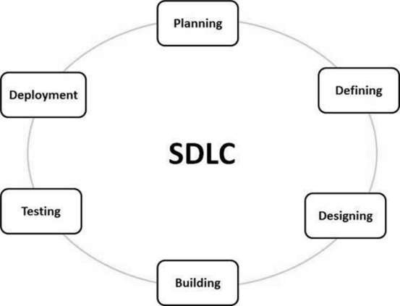
SDLC

Slide 24
Requirements & Analysis
Project Planning
Design
Coding & Implementation
Testing
Deployment
Maintenance

Slide 25
Stage 1: Planning and Requirement Analysis
Requirement analysis is the most important and fundamental stage in SDLC. It is performed by the senior members of the team with inputs from the customer, the sales department, market surveys and domain experts in the industry. This information is then used to plan the basic project approach and to conduct product feasibility study in the economical, operational and technical areas.
Planning for the quality assurance requirements and identification of the risks associated with the project is also done in the planning stage. The outcome of the technical feasibility study is to define the various technical approaches that can be followed to implement the project successfully with minimum risks.

Slide 26
Stage 2: Defining Requirements
Once the requirement analysis is done the next step is to clearly define and document the product requirements and get them approved from the customer or the market analysts. This is done through an SRS (Software Requirement Specification) document which consists of all the product requirements to be designed and developed during the project life cycle.

Slide 27
Stage 3: Designing the Product Architecture
SRS is the reference for product architects to come out with the best architecture for the product to be developed. Based on the requirements specified in SRS, usually more than one design approach for the product architecture is proposed and documented in a DDS - Design Document Specification.
This DDS is reviewed by all the important stakeholders and based on various parameters as risk assessment, product robustness, design modularity, budget and time constraints, the best design approach is selected for the product.
A design approach clearly defines all the architectural modules of the product along with its communication and data flow representation with the external and third party modules (if any). The internal design of all the modules of the proposed architecture should be clearly defined with the minutest of the details in DDS.

Slide 28
Stage 4: Building or Developing the Product
In this stage of SDLC the actual development starts and the product is built. The programming code is generated as per DDS during this stage. If the design is performed in a detailed and organized manner, code generation can be accomplished without much hassle.
Developers must follow the coding guidelines defined by their organization and programming tools like compilers, interpreters, debuggers, etc. are used to generate the code. Different high level programming languages such as C, C++, Pascal, Java and PHP are used for coding. The programming language is chosen with respect to the type of software being developed.

Slide 29
Stage 5: Testing the Product
This stage is usually a subset of all the stages as in the modern SDLC models, the testing activities are mostly involved in all the stages of SDLC. However, this stage refers to the testing only stage of the product where product defects are reported, tracked, fixed and retested, until the product reaches the quality standards defined in the SRS.

Slide 30
Stage 6: Deployment in the Market and Maintenance
Once the product is tested and ready to be deployed it is released formally in the appropriate market. Sometimes product deployment happens in stages as per the business strategy of that organization. The product may first be released in a limited segment and tested in the real business environment (UAT- User acceptance testing).
Then based on the feedback, the product may be released as it is or with suggested enhancements in the targeting market segment. After the product is released in the market, its maintenance is done for the existing customer base.

Slide 31
SDLC Models
There are various software development life cycle models defined and designed which are followed during the software development process. These models are also referred as Software Development Process Models". Each process model follows a Series of steps unique to its type to ensure success in the process of software development.

Slide 32
Following are the most important and popular SDLC models followed in the industry −
Waterfall Model
Iterative Model
Spiral Model
V-Model
Big Bang Model

Slide 33
WATERFALL MODEL

Slide 34
Waterfall Model
The Waterfall Model was the first Process Model to be introduced. It is also referred to as a linear-sequential life cycle model. It is very simple to understand and use. In a waterfall model, each phase must be completed before the next phase can begin and there is no overlapping in the phases.
The Waterfall model is the earliest SDLC approach that was used for software development.
The waterfall Model illustrates the software development process in a linear sequential flow. This means that any phase in the development process begins only if the previous phase is complete. In this waterfall model, the phases do not overlap.

Slide 35
Waterfall Model - Design
Waterfall approach was first SDLC Model to be used widely in Software Engineering to ensure success of the project. In "The Waterfall" approach, the whole process of software development is divided into separate phases. In this Waterfall model, typically, the outcome of one phase acts as the input for the next phase sequentially.
The following illustration is a representation of the different phases of the Waterfall Model.

Slide 36
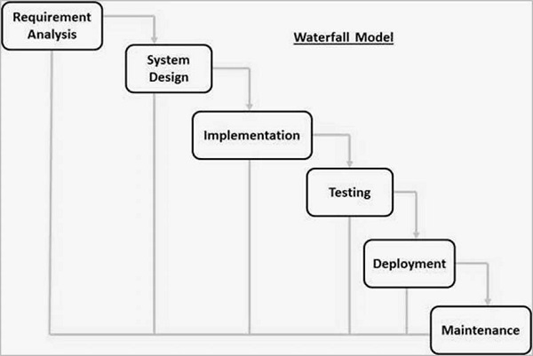

Slide 37
The sequential phases in Waterfall model are −
Requirement Gathering and analysis − All possible requirements of the system to be developed are captured in this phase and documented in a requirement specification document.
System Design − The requirement specifications from first phase are studied in this phase and the system design is prepared. This system design helps in specifying hardware and system requirements and helps in defining the overall system architecture.
Implementation − With inputs from the system design, the system is first developed in small programs called units, which are integrated in the next phase. Each unit is developed and tested for its functionality, which is referred to as Unit Testing.

Slide 38
Integration and Testing − All the units developed in the implementation phase are integrated into a system after testing of each unit. Post integration the entire system is tested for any faults and failures.
Deployment of system − Once the functional and non-functional testing is done; the product is deployed in the customer environment or released into the market.
Maintenance − There are some issues which come up in the client environment. To fix those issues, patches are released. Also to enhance the product some better versions are released. Maintenance is done to deliver these changes in the customer environment.

Slide 39
All these phases are cascaded to each other in which progress is seen as flowing steadily downwards (like a waterfall) through the phases. The next phase is started only after the defined set of goals are achieved for previous phase and it is signed off, so the name "Waterfall Model".
In this model, phases do not overlap.

Slide 40
Waterfall Model - Application
Every software developed is different and requires a suitable SDLC approach to be followed based on the internal and external factors. Some situations where the use of Waterfall model is most appropriate are −
Requirements are very well documented, clear and fixed.
Product definition is stable.
Technology is understood and is not dynamic.
There are no ambiguous requirements.
Ample resources with required expertise are available to support the product.
The project is short.

Slide 41
Waterfall Model - Advantages
The advantages of waterfall development are that it allows for departmentalization and control. A schedule can be set with deadlines for each stage of development and a product can proceed through the development process model phases one by one.
Development moves from concept, through design, implementation, testing, installation, troubleshooting, and ends up at operation and maintenance. Each phase of development proceeds in strict order.

Slide 42
Some of the major advantages of the Waterfall Model are as follows −
Simple and easy to understand and use
Easy to manage due to the rigidity of the model. Each phase has specific deliverables and a review process.
Phases are processed and completed one at a time.
Works well for smaller projects where requirements are very well understood.
Clearly defined stages.
Well understood milestones.
Easy to arrange tasks.
Process and results are well documented.

Slide 43
Waterfall Model - Disadvantages
The disadvantage of waterfall development is that it does not allow much reflection or revision. Once an application is in the testing stage, it is very difficult to go back and change something that was not well-documented or thought upon in the concept stage.

Slide 44
The major disadvantages of the Waterfall Model are as follows −
No working software is produced until late during the life cycle.
High amounts of risk and uncertainty.
Not a good model for complex and object-oriented projects.
Poor model for long and ongoing projects.
Not suitable for the projects where requirements are at a moderate to high risk of changing. So, risk and uncertainty is high with this process model.
It is difficult to measure progress within stages.
Cannot accommodate changing requirements.
Adjusting scope during the life cycle can end a project.

Slide 46
Spiral Model

Slide 47
Spiral model is one of the most important Software Development Life Cycle models, which provides support for Risk Handling. In its diagrammatic representation, it looks like a spiral with many loops.
The exact number of loops of the spiral is unknown and can vary from project to project. Each loop of the spiral is called a Phase of the software development process.
The exact number of phases needed to develop the product can be varied by the project manager depending upon the project risks.
As the project manager dynamically determines the number of phases, so the project manager has an important role to develop a product using the spiral model.

Slide 48
The Radius of the spiral at any point represents the expenses(cost) of the project so far, and the angular dimension represents the progress made so far in the current phase.

Slide 49
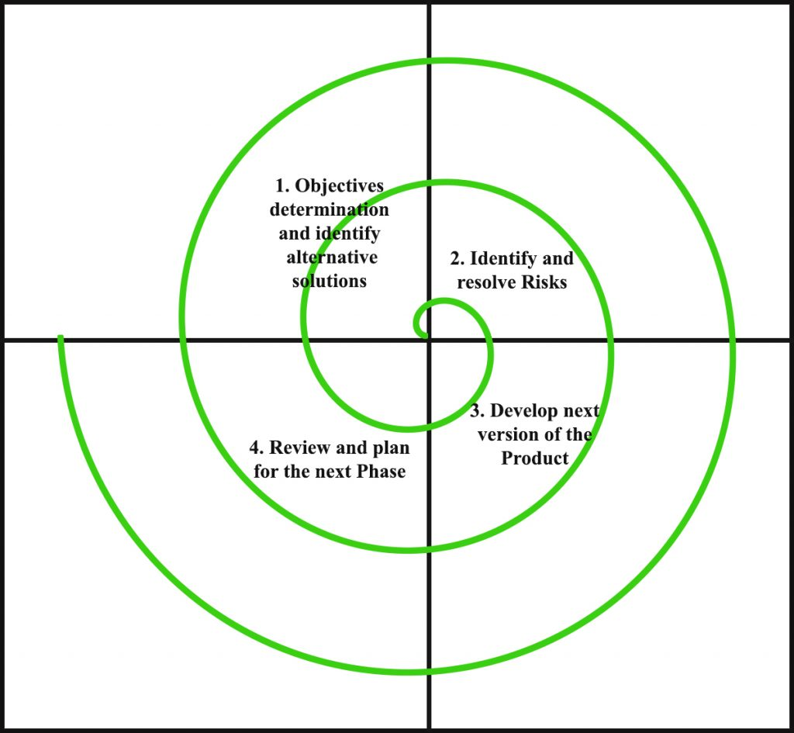

Slide 50
Each phase of the Spiral Model is divided into four quadrants as shown in the above figure. The functions of these four quadrants are discussed below-
1.Objectives determination and identify alternative solutions: Requirements are gathered from the customers and the objectives are identified, elaborated, and analyzed at the start of every phase. Then alternative solutions possible for the phase are proposed in this quadrant.

Slide 51
2.Identify and resolve Risks: During the second quadrant, all the possible solutions are evaluated to select the best possible solution. Then the risks associated with that solution are identified and the risks are resolved using the best possible strategy. At the end of this quadrant, the Prototype is built for the best possible solution.

Slide 52
3.Develop next version of the Product: During the third quadrant, the identified features are developed and verified through testing. At the end of the third quadrant, the next version of the software is available.

Slide 53
4. Review and plan for the next Phase: In the fourth quadrant, the Customers evaluate the so far developed version of the software. In the end, planning for the next phase is started.

Slide 54
Risk Handling in Spiral Model
A risk is any adverse situation that might affect the successful completion of a software project.
The most important feature of the spiral model is handling these unknown risks after the project has started.
Such risk resolutions are easier done by developing a prototype.
The spiral model supports coping up with risks by providing the scope to build a prototype at every phase of the software development.

Slide 55
Advantages of Spiral Model:
Risk Handling: The projects with many unknown risks that occur as the development proceeds, in that case, Spiral Model is the best development model to follow due to the risk analysis and risk handling at every phase.
Good for large projects: It is recommended to use the Spiral Model in large and complex projects.
Flexibility in Requirements: Change requests in the Requirements at later phase can be incorporated accurately by using this model.
Customer Satisfaction: Customer can see the development of the product at the early phase of the software development and thus, they habituated with the system by using it before completion of the total product.

Slide 56
Disadvantages of Spiral Model:
Complex: The Spiral Model is much more complex than other SDLC models.
Expensive: Spiral Model is not suitable for small projects as it is expensive.
Too much dependability on Risk Analysis: The successful completion of the project is very much dependent on Risk Analysis. Without very highly experienced experts, it is going to be a failure to develop a project using this model.
Difficulty in time management: As the number of phases is unknown at the start of the project, so time estimation is very difficult.

Slide 57
Prototyping Model
Prototyping is defined as the process of developing a working replication of a product or system that has to be engineered. It offers a small scale facsimile of the end product and is used for obtaining customer feedback as described below:

Slide 58
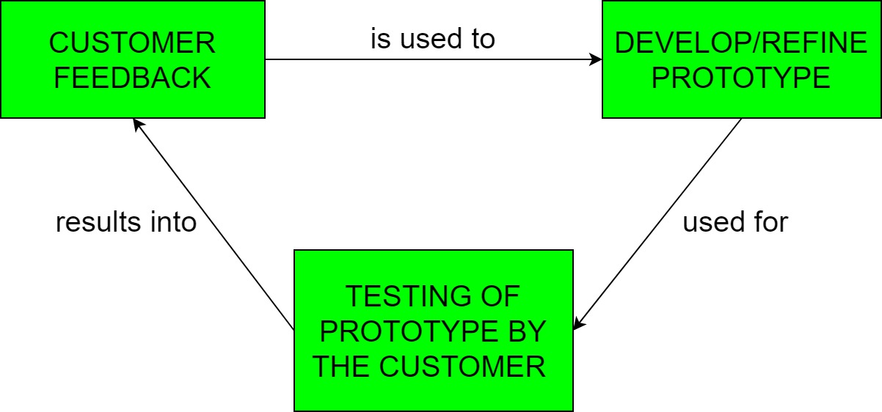

Slide 59
The Prototyping Model is one of the most popularly used Software Development Life Cycle Models (SDLC models).
This model is used when the customers do not know the exact project requirements beforehand.
In this model, a prototype of the end product is first developed, tested and refined as per customer feedback repeatedly till a final acceptable prototype is achieved which forms the basis for developing the final product.

Slide 60
In this process model, the system is partially implemented before or during the analysis phase thereby giving the customers an opportunity to see the product early in the life cycle.
The process starts by interviewing the customers and developing the incomplete high-level paper model.
This document is used to build the initial prototype supporting only the basic functionality as desired by the customer.
Once the customer figures out the problems, the prototype is further refined to eliminate them.
The process continues until the user approves the prototype and finds the working model to be satisfactory.

Slide 61
There are four types of models available:
A) Rapid Throwaway Prototyping – This technique offers a useful method of exploring ideas and getting customer feedback for each of them. In this method, a developed prototype need not necessarily be a part of the ultimately accepted prototype. Customer feedback helps in preventing unnecessary design faults and hence, the final prototype developed is of better quality.

Slide 62
B) Evolutionary Prototyping – In this method, the prototype developed initially is incrementally refined on the basis of customer feedback till it finally gets accepted. In comparison to Rapid Throwaway Prototyping, it offers a better approach which saves time as well as effort. This is because developing a prototype from scratch for every iteration of the process can sometimes be very frustrating for the developers.

Slide 63
C) Incremental Prototyping – In this type of incremental Prototyping, the final expected product is broken into different small pieces of prototypes and being developed individually.
In the end, when all individual pieces are properly developed, then the different prototypes are collectively merged into a single final product in their predefined order.
It’s a very efficient approach that reduces the complexity of the development process, where the goal is divided into sub-parts and each sub-part is developed individually.
The time interval between the project’s beginning and final delivery is substantially reduced because all parts of the system are prototyped and tested simultaneously.
Of course, there might be the possibility that the pieces just do not fit together due to some lack of ness in the development phase – this can only be fixed by careful and complete plotting of the entire system before prototyping starts.

Slide 64
D) Extreme Prototyping – This method is mainly used for web development. It is consists of three sequential independent phases:
D.1) In this phase a basic prototype with all the existing static pages are presented in the HTML format.
D.2) In the 2nd phase, Functional screens are made with a simulated data process using a prototype services layer.
D.3) This is the final step where all the services are implemented and associated with the final prototype.

Slide 65
Advantages –
The customers get to see the partial product early in the life cycle. This ensures a greater level of customer satisfaction and comfort.
New requirements can be easily accommodated as there is scope for refinement.
Missing functionalities can be easily figured out.
Errors can be detected much earlier thereby saving a lot of effort and cost, besides enhancing the quality of the software.
The developed prototype can be reused by the developer for more complicated projects in the future.
Flexibility in design.

Slide 66
Disadvantages –
Costly w.r.t time as well as money.
There may be too much variation in requirements each time the prototype is evaluated by the customer.
Poor Documentation due to continuously changing customer requirements.
It is very difficult for developers to accommodate all the changes demanded by the customer.
There is uncertainty in determining the number of iterations that would be required before the prototype is finally accepted by the customer.
After seeing an early prototype, the customers sometimes demand the actual product to be delivered soon.
Developers in a hurry to build prototypes may end up with sub-optimal solutions.
The customer might lose interest in the product if he/she is not satisfied with the initial prototype.

Slide 67
Use – The Prototyping Model should be used when the requirements of the product are not clearly understood or are unstable. It can also be used if requirements are changing quickly. This model can be successfully used for developing user interfaces, high technology software-intensive systems, and systems with complex algorithms and interfaces. It is also a very good choice to demonstrate the technical feasibility of the product.

Slide 68
RAD Model
The RAD (Rapid Application Development) model is based on prototyping and iterative development with no specific planning involved. The process of writing the software itself involves the planning required for developing the product.
Rapid Application Development focuses on gathering customer requirements through workshops or focus groups, early testing of the prototypes by the customer using iterative concept, reuse of the existing prototypes (components), continuous integration and rapid delivery.

Slide 69
What is RAD?
Rapid application development is a software development methodology that uses minimal planning in favor of rapid prototyping. A prototype is a working model that is functionally equivalent to a component of the product.
In the RAD model, the functional modules are developed in parallel as prototypes and are integrated to make the complete product for faster product delivery. Since there is no detailed preplanning, it makes it easier to incorporate the changes within the development process.

Slide 70
RAD projects follow iterative and incremental model and have small teams comprising of developers, domain experts, customer representatives and other IT resources working progressively on their component or prototype.
The most important aspect for this model to be successful is to make sure that the prototypes developed are reusable.

Slide 71
RAD Model Design
RAD model distributes the analysis, design, build and test phases into a series of short, iterative development cycles.
Following are the various phases of the RAD Model −

Slide 72
Business Modelling
The business model for the product under development is designed in terms of flow of information and the distribution of information between various business channels.
A complete business analysis is performed to find the vital information for business, how it can be obtained, how and when is the information processed and what are the factors driving successful flow of information.

Slide 73
Data Modelling
The information gathered in the Business Modelling phase is reviewed and analyzed to form sets of data objects vital for the business.
The attributes of all data sets is identified and defined.
The relation between these data objects are established and defined in detail in relevance to the business model.

Slide 74
Process Modelling
The data object sets defined in the Data Modelling phase are converted to establish the business information flow needed to achieve specific business objectives as per the business model.
The process model for any changes or enhancements to the data object sets is defined in this phase.
Process descriptions for adding, deleting, retrieving or modifying a data object are given.

Slide 75
Application Generation
The actual system is built and coding is done by using automation tools to convert process and data models into actual prototypes.

Slide 76
Testing and Turnover
The overall testing time is reduced in the RAD model as the prototypes are independently tested during every iteration.
However, the data flow and the interfaces between all the components need to be thoroughly tested with complete test coverage.
Since most of the programming components have already been tested, it reduces the risk of any major issues.

Slide 77
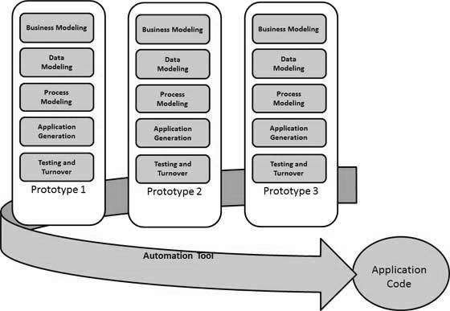

Slide 78
RAD Model - Application
RAD should be used only when a system can be modularized to be delivered in an incremental manner.
It should be used if there is a high availability of designers for Modelling.
It should be used only if the budget permits use of automated code generating tools.
RAD SDLC model should be chosen only if domain experts are available with relevant business knowledge.
Should be used where the requirements change during the project and working prototypes are to be presented to customer in small iterations of 2-3 months.

Slide 79
The advantages of the RAD Model are as follows −
Changing requirements can be accommodated.
Progress can be measured.
Iteration time can be short with use of powerful RAD tools.
Productivity with fewer people in a short time.
Reduced development time.
Increases reusability of components.
Quick initial reviews occur.
Encourages customer feedback.
Integration from very beginning solves a lot of integration issues.

Slide 80
The disadvantages of the RAD Model are as follows −
Dependency on technically strong team members for identifying business requirements.
Only system that can be modularized can be built using RAD.
Requires highly skilled developers/designers.
High dependency on Modelling skills.
Inapplicable to cheaper projects as cost of Modelling and automated code generation is very high.
Management complexity is more.
Suitable for systems that are component based and scalable.
Requires user involvement throughout the life cycle.
Suitable for project requiring shorter development times.

Slide 81
Rational Unified Process (RUP) is a software development process for object-oriented models. It is also known as the Unified Process Model. It is created by Rational corporation and is designed and documented using UML (Unified Modeling Language). This process is included in IBM Rational Method Composer (RMC) product. IBM (International Business Machine Corporation) allows us to customize, design, and personalize the unified process. RUP is proposed by Ivar Jacobson, Grady Bootch, and James Rambaugh. Some characteristics of RUP include use-case driven, Iterative (repetition of the process), and Incremental (increase in value) by nature, delivered online using web technology, can be customized or tailored in modular and electronic form, etc. RUP reduces unexpected development costs and prevents wastage of resources.

